Slide 1
TETTENHALL TENNIS CLUB All of these benefits in a beautiful setting on the outskirts of Wolverhampton
Social membership to Wolverhampton Cricket Club, access to all facilties, and bar discount
Q1
Unlimited use of the tennis courts (subject to fair usage)
Q1
Q1
Q1
LTA membership included in fee
Q1
Free and plentiful parking
Q2
Q2
Q2
Access to LTA run ballot for Wimbledon tickets
Q2
Juniors - 1 free hour a week group coaching
Q2
Q3
Q3
Q3
Q3
Adults - free 1.5 hour monthly Club activity session
Intra-club tournaments & competitive county Staffs League matches
Q3
A buoyant and inclusive social group
Q4
Q4
Active social media accounts, webpage, email & text messaging communication
Q4
Q4
Free use of floodlights
CCA qualified Head coach, plus assistant coaches
Q4
*Subject to fair usage

Slide 2
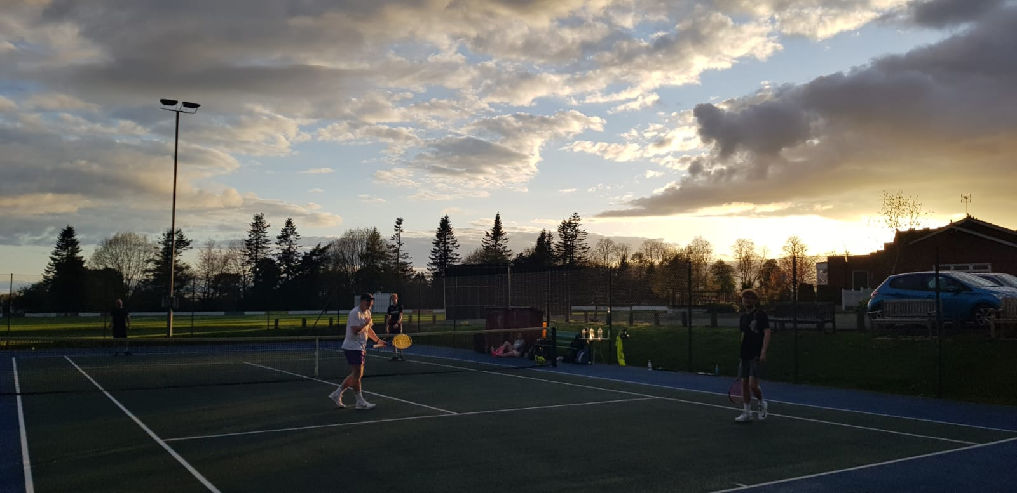
TETTENHALL TENNIS CLUB – our prices
Less than £3 per week (£140 pa) for adult membership (Couples£250 pa)
Less than £1.50 per week (£70 pa) for Under 18 membership (inc Students)
Around a £1 per week (£55 pa) for Under 12 membership
Less than 50p per week (£20 pa) for our mini (U8)membership
3 month trial membership available
email us on tettenhalltennis@gmail.com Mobile: 07848 877858 (text messages only)
Or visit our website on www.tettenhalltennisclub.co.uk

